Slide 1
SALES ANALYSIS OF MOBILE PHONE BRANDS IN INDIA FROM 2017-2022
-Karun Pramod
Dhanush S R
Arun Vignesh

Slide 2
Introduction
The aim of this project is to compare the sales of various mobile phone companies for the past six years and predict which company is the most dominant and consistent in the Indian market from 2017 - 2022
The dataset has been imported from Kaggle
For analysis of the Dataset R Programming language is used and the software used for the analysis is R Studio

Slide 3
Project Division
This project has been divided into three parts:
Analysis of Indian Phone Companies
Analysis of Other foreign Companies
Analysis of Samsung

Slide 4
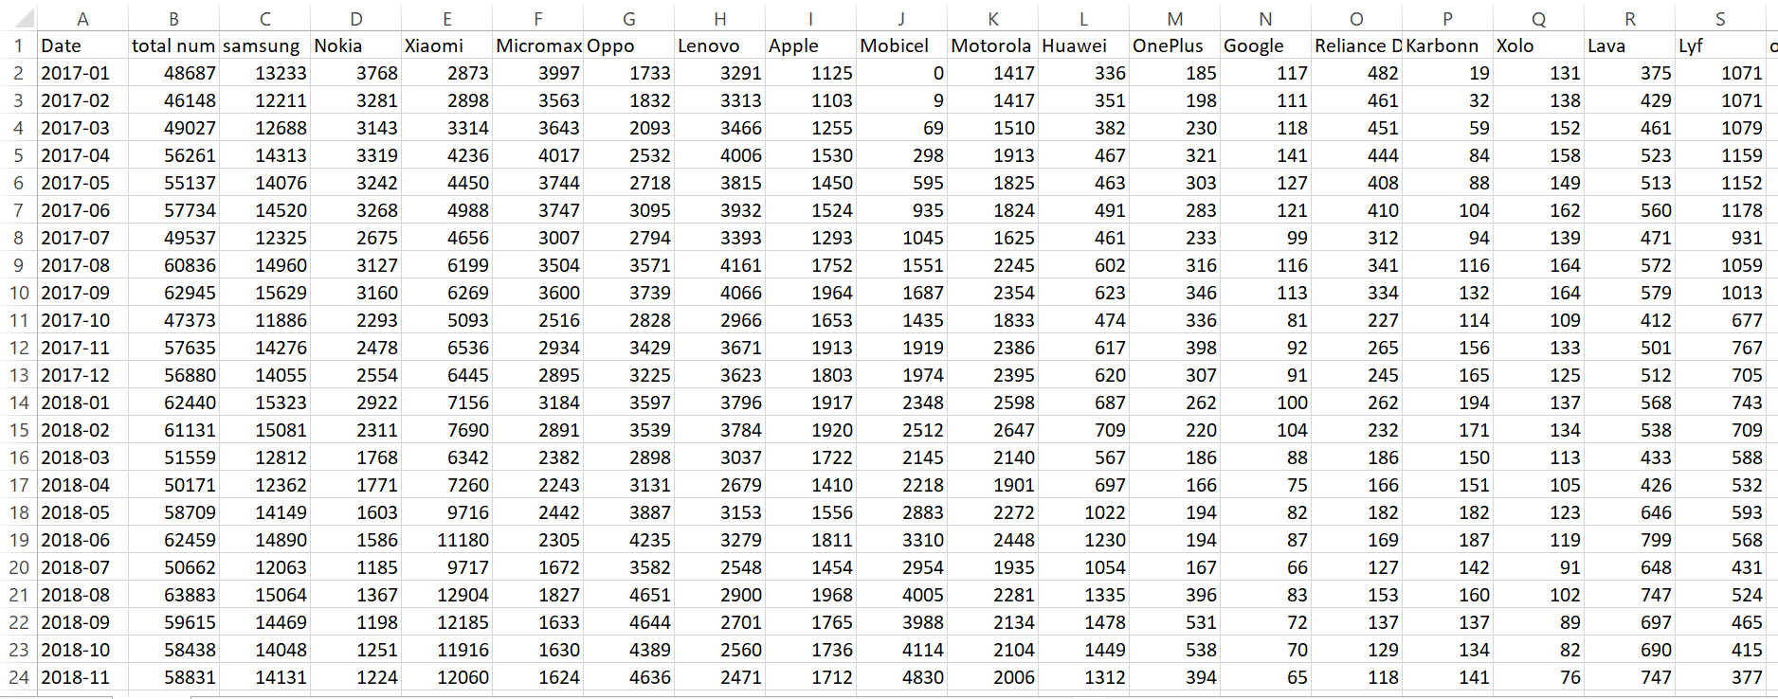
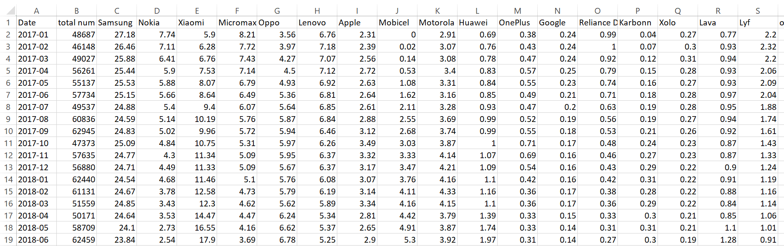
Dataset in Raw Form
DATASET :
pbmsi_values
Elements / cells : integers
DATASET : pbmsi_percentage
Elements/cells : percentage form

Slide 5
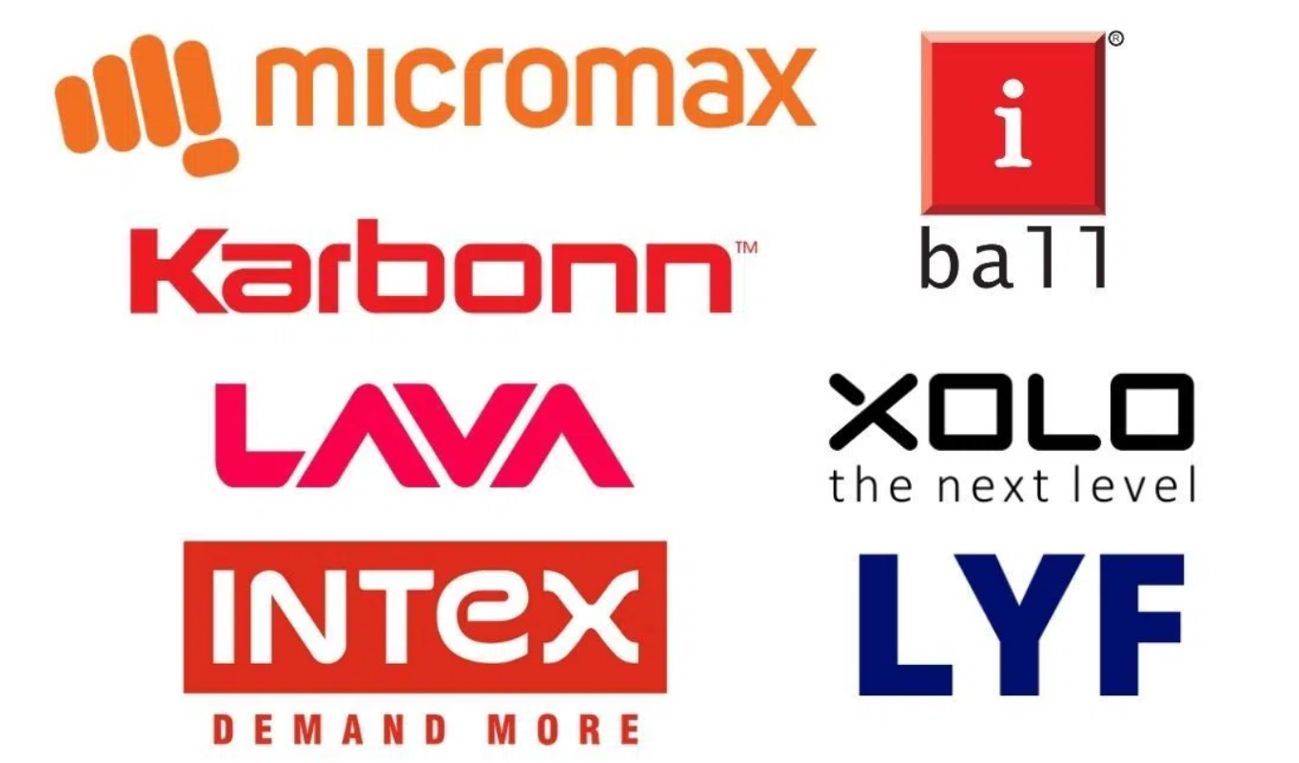
Analysis of Indian Mobile Phone Brands from 2017-2022 in Indian Market

Slide 6
Year wise analysis of Mean and Standard deviation of Indian mobile phone brand

Slide 7
% / Prob market share of Indian brands from 2017-2022 in Indian market

Slide 8
Indian Mobile Brand sales Analysis during COVID-19 phase
14442
TOTAL SALES OF INDIAN MOBILE PHONE BRANDS DURING COVID 19
0.0128
PROBABILITY OF INDIAN PHONE BRANDS SELLING DURING COVID 19
PROBABILITY OF INDIAN PHONE BRAND SELLING DURING COVID 19 PHASE GRAPH

Slide 9
Coefficient Of Correlation between Indian and Foreign Brands from 2017 - 2022
-0.8310
Pearson’s CC
-0.6978
Spearman’s CC

Slide 10
PIE CHARTS :
Foreign Mobile phone brands VS Indian Mobile Phone Brands 2017 -2022
Indian Brands Market Share in India from 2017 - 2022

Slide 11
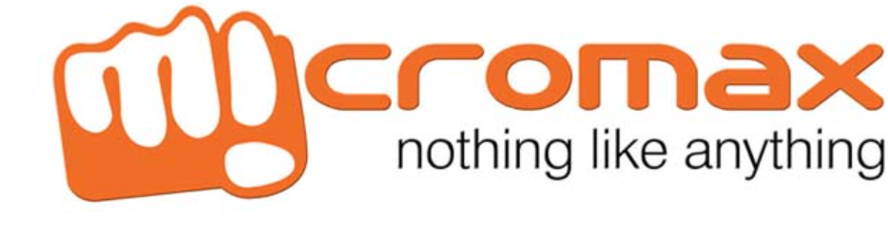
Analysis of Leading Indian Mobile Phone Brand

Slide 12
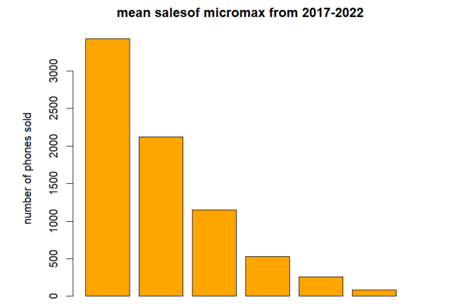
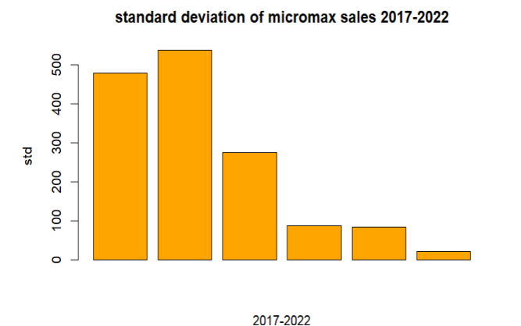


Mean and SD Sales of Micromax
2017
2018
2019
2020
2021
2022

Slide 13
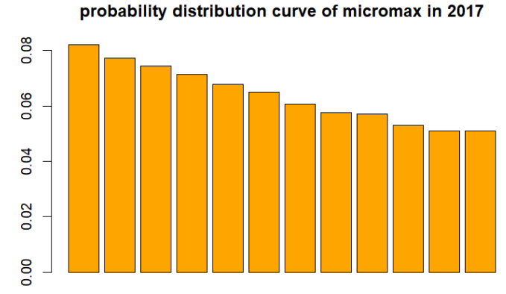
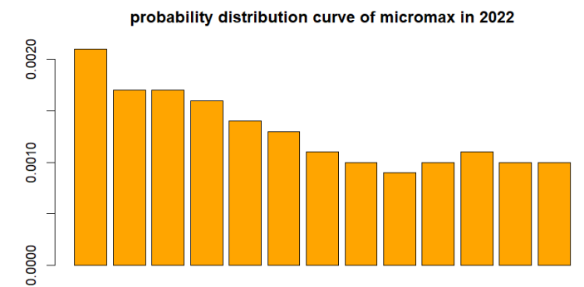
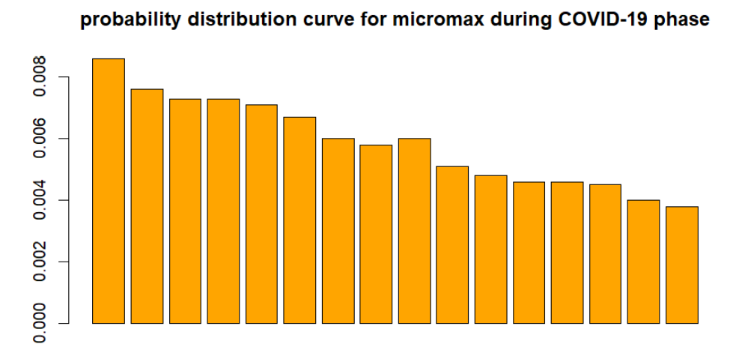
Probability Distribution Curve for Sales in Specific Years

Slide 14
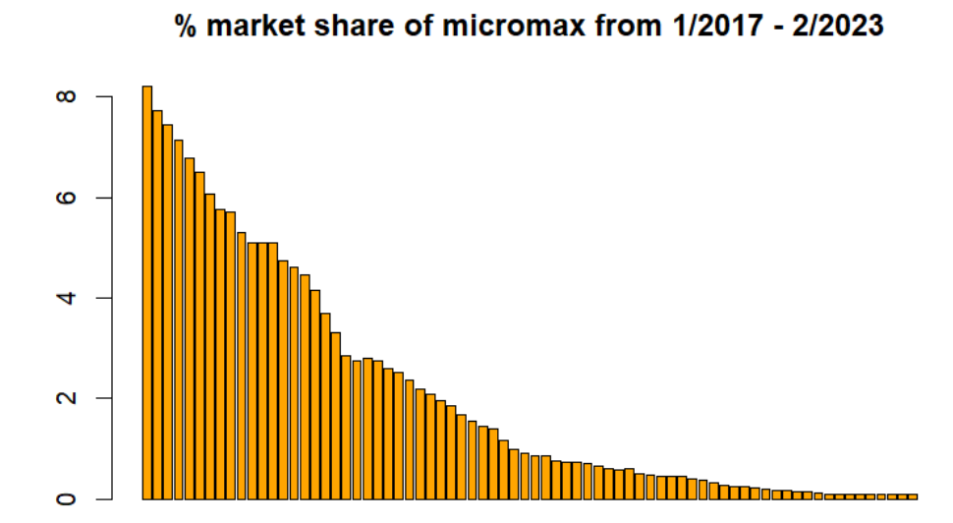
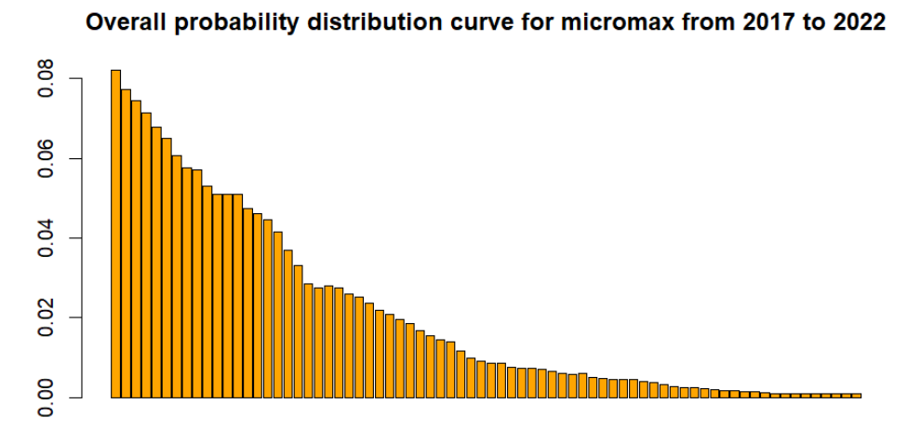
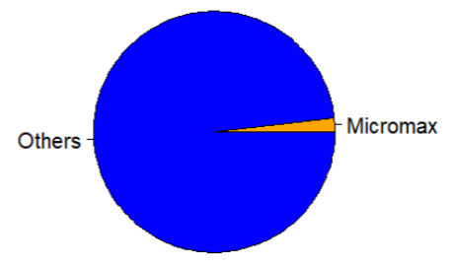
%/prob , Overall of Sales in the Indian Market

Slide 15
Correlation Coefficient of Micromax with Other Brands
Pearson Correlation Coefficient :
-0.8149
Spearman Correlation Coefficient :
-0.6823

Slide 16
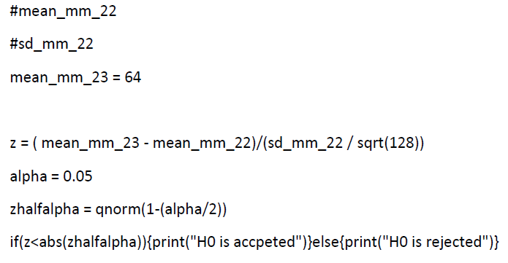
Hypothesis Testing for Micromax
If the mean sales of Micromax for the year 2022 is some value(k22)
in a sample{January 2023 , February 2023} the mean sales of Micromax is some value(k23)
The Marketing Director of Micromax say that the expected sales of Micromax this year 2023 will be greater than last year
At 0.05 significance level , can we accept his statement
THEREFORE HIS/HER STATEMENT IS TRUE and POSSIBLE !!!

Slide 17
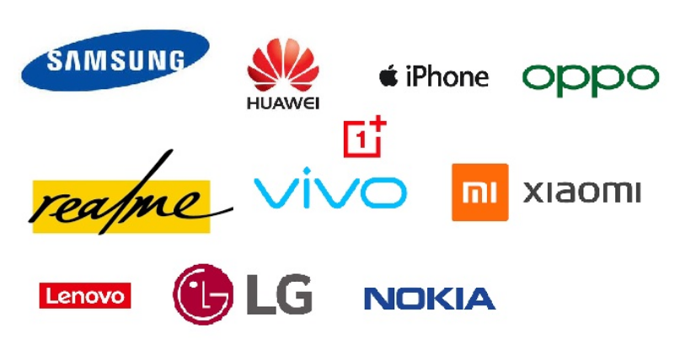
Analysis of Foreign Companies

Slide 18
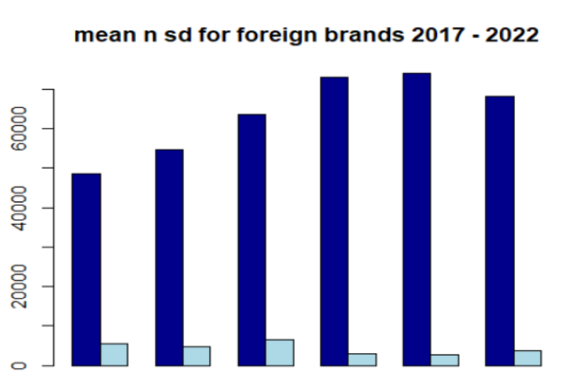
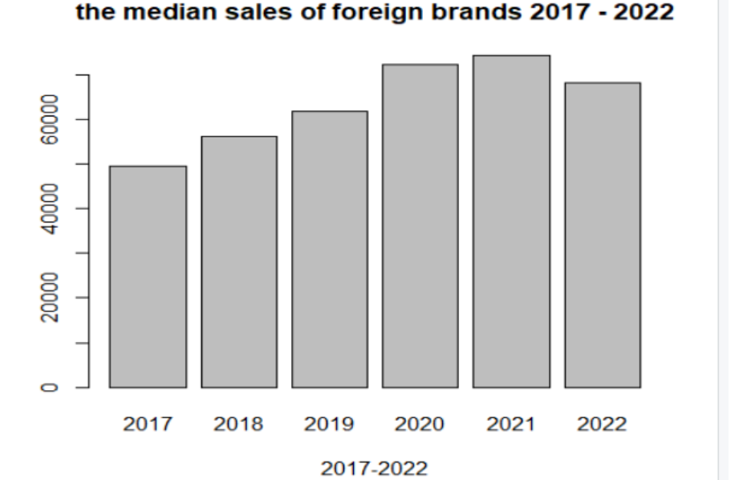
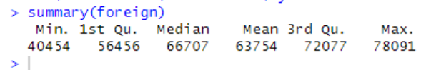
Mean,Median,SD of Sales of Foreign Brands

Slide 19
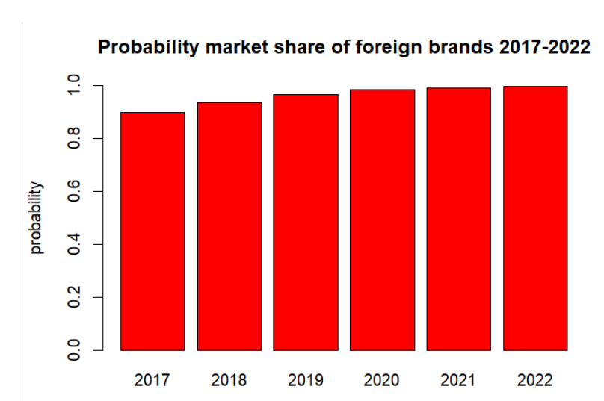
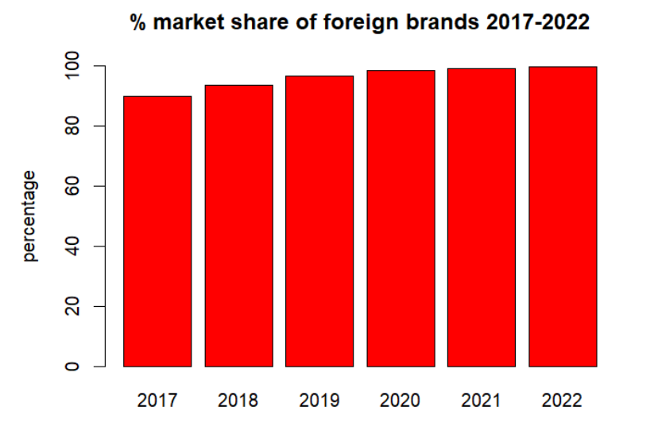
%/prob of Sales in the World Market

Slide 20
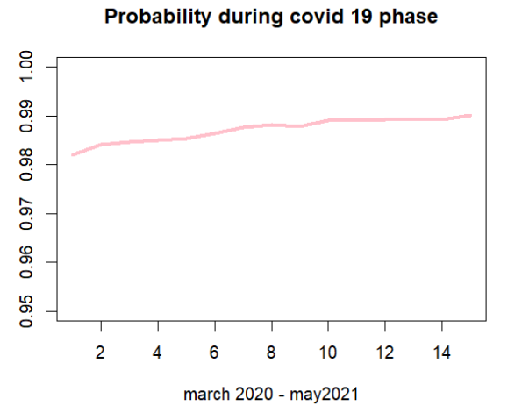
Probability Distribution Curve for Sales during COVID-19

Slide 21
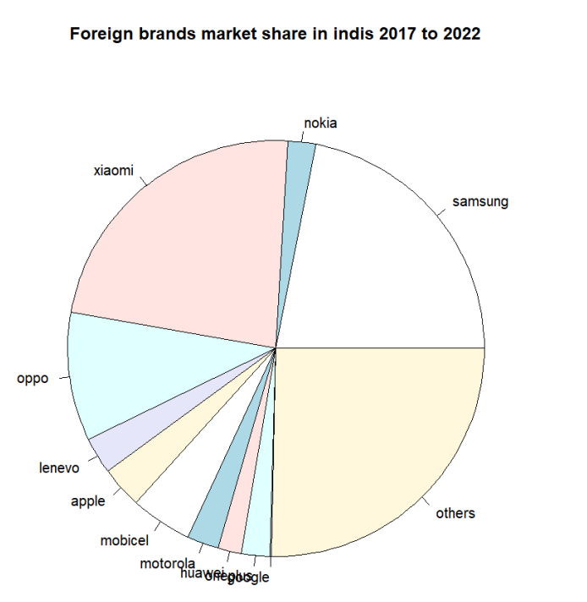
Analysis of Sales of Individual Foreign Brands
Others =
{
Vivo,Realme,Sony,BBK,HTC,Asus,LG,Spice,Tenco,Panasonic,Itel,LeEco,Infinix,RIM,Alcatel,InFocus,ZTE,Comio,Infinex,Mobiistar,HP,Opp,QMobile,Meizu
}

Slide 22
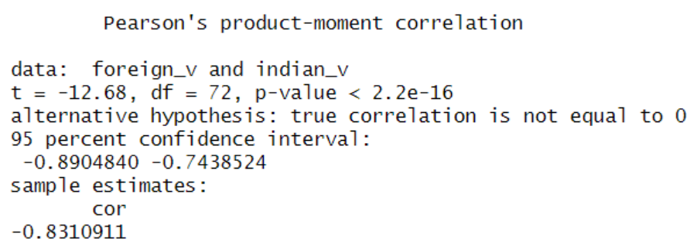
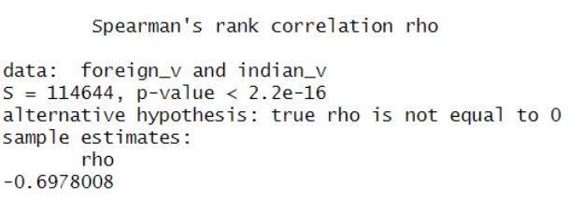
Correlation with Other Companies
Pearson’s Correlation Coefficient
Spearman’s Rank Coefficient

Slide 23
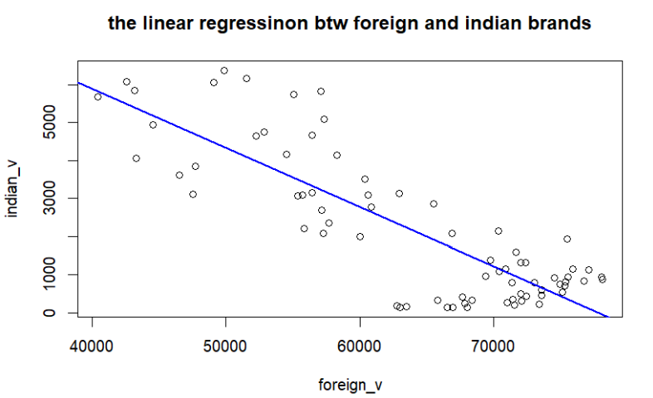
Regression of Foreign vs Indian Brands

Slide 24
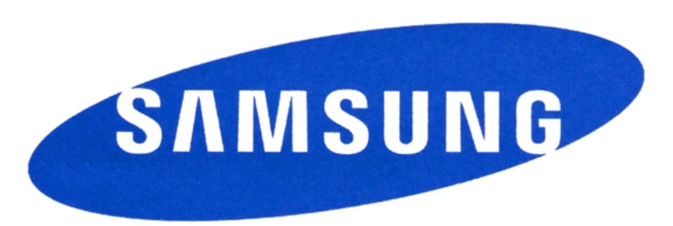
Analysis of Samsung Phones Sold in India 2017 - 2022

Slide 25
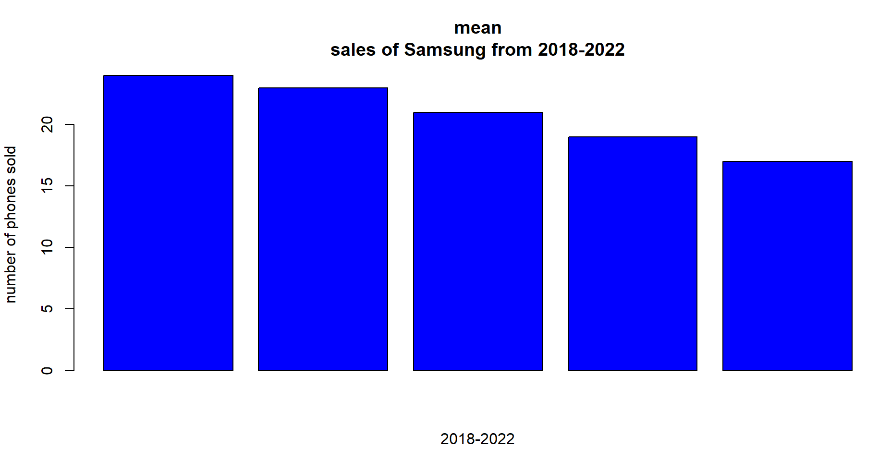
Mean Sales of Samsung Phones

Slide 26
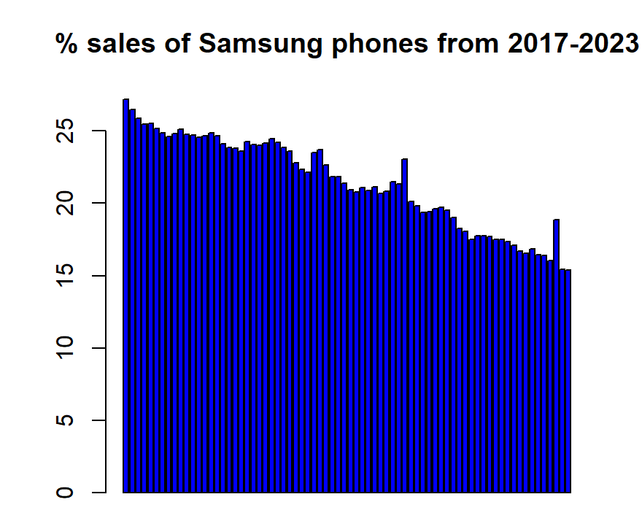
Percentage of Sales in Indian Market

Slide 27
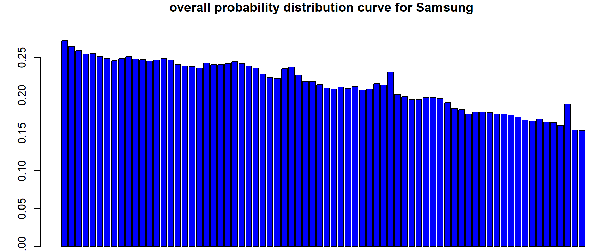
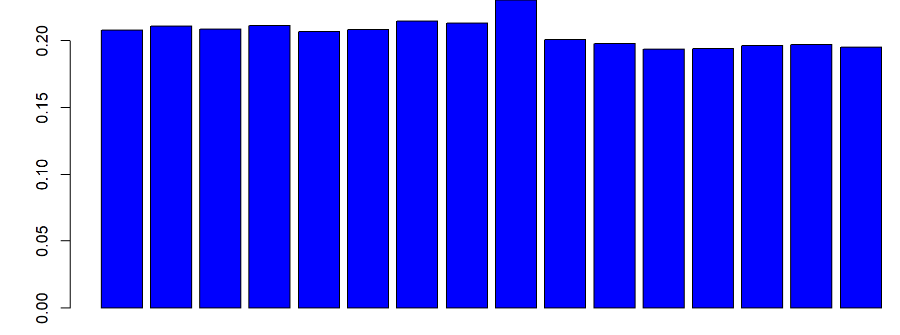
Probability Distribution Curve of Samsung
Overall Probability of sales ,distribution curve for Samsung from 2017 to 2022
Probability distribution curve for Samsung during COVID-19

Slide 28
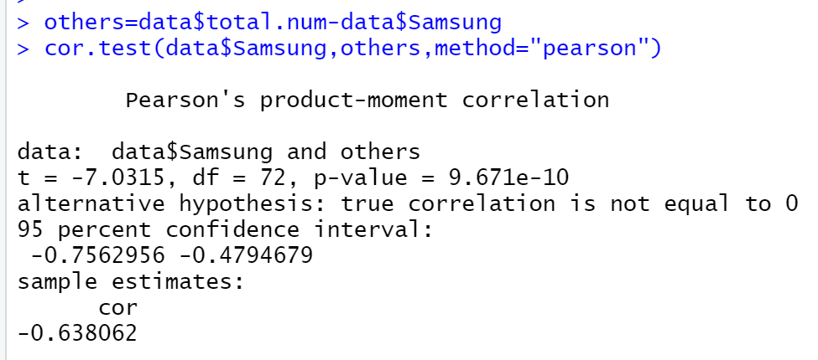
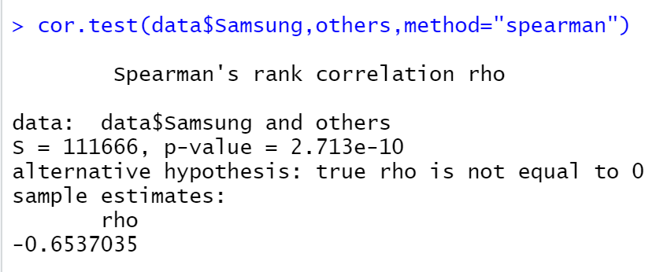
Correlation with Other Companies
Pearson’s Correlation Coefficient
Spearman’s Rank Coefficient

Slide 29
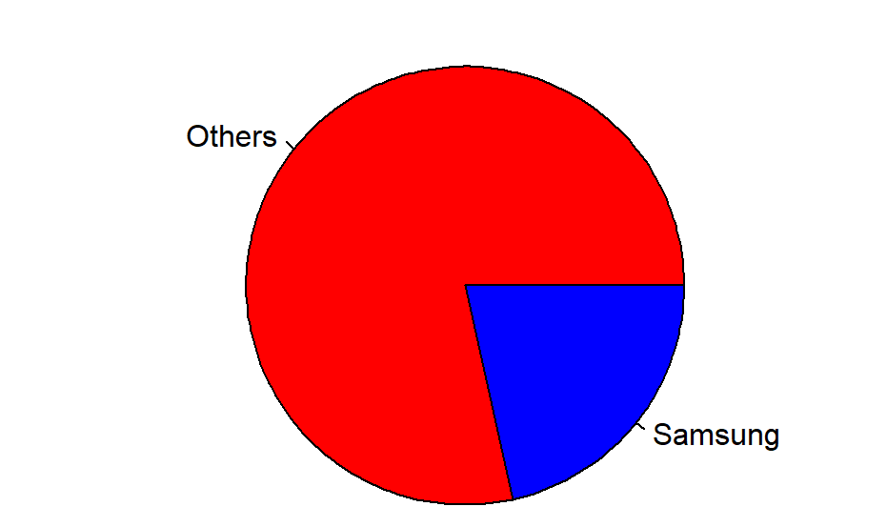
Overall Indian Market Share of Samsung

Slide 30
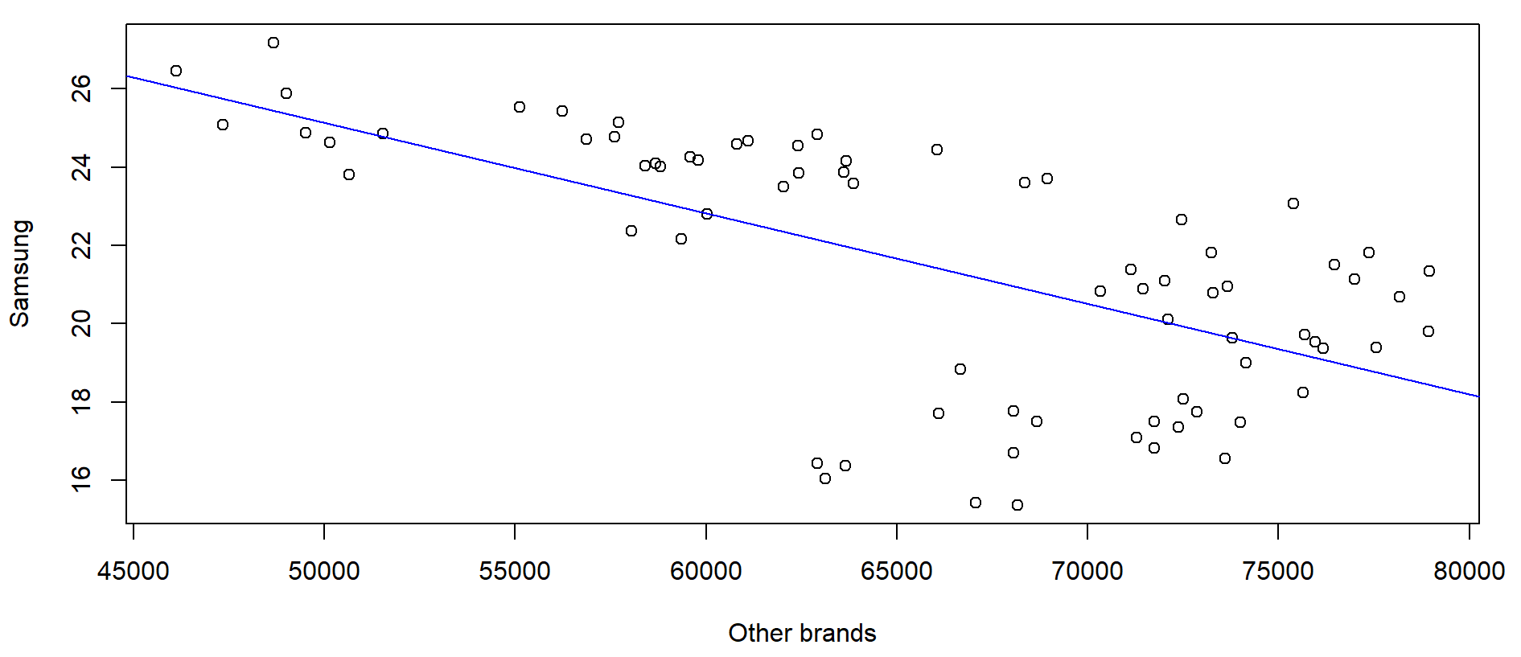
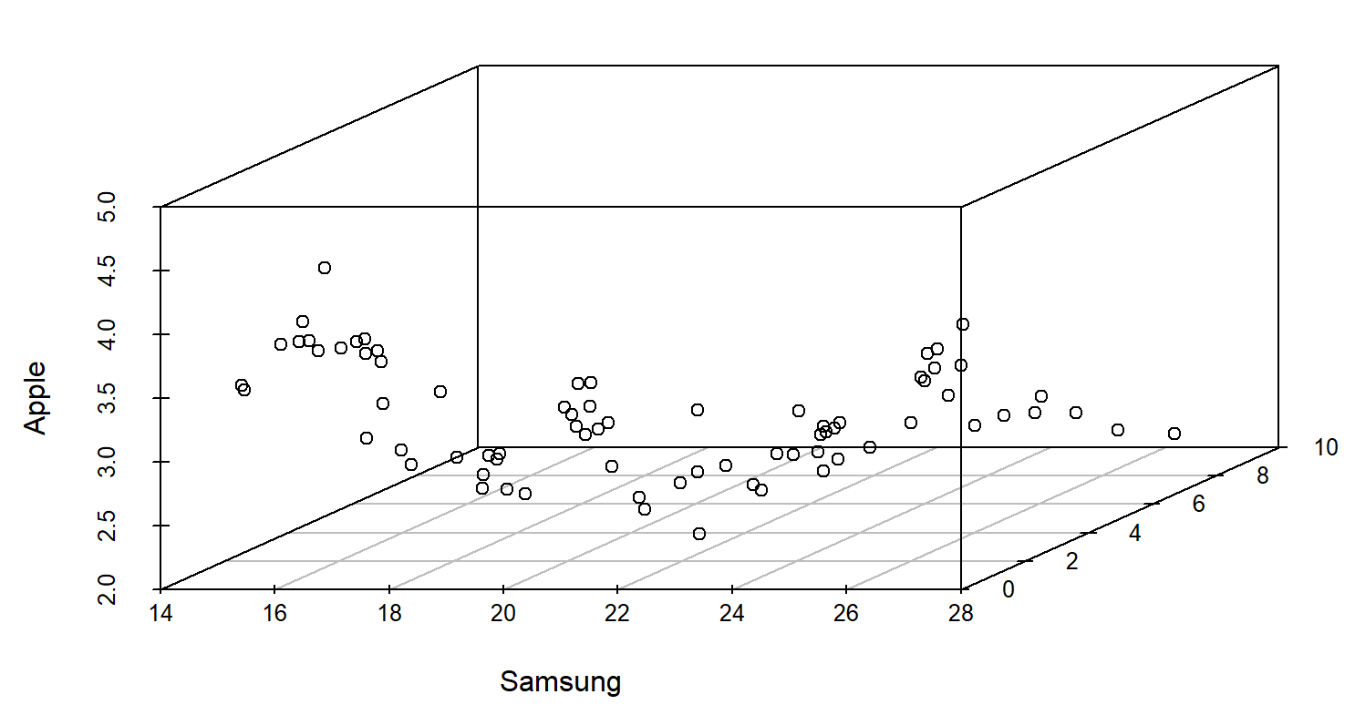
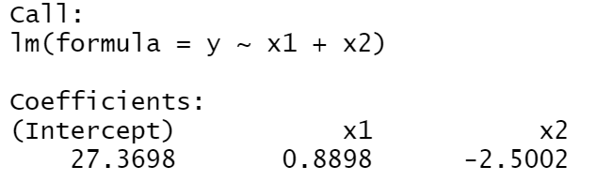
Regression of Samsung vs Other Brands
LINEAR REGRESSION
MULTIPLE REGRESSION
Micromax
-Samsung
-Apple
-Micromax

Slide 31
CONCULSION
Indian Mobile Phone market(IMPM) is important to the world
There are more than 40 mobile phone brands trying to sell and manufacture their products in India
Nokia failed to embrace cutting edge technologies => losing the IMPM in late period of the last decade
Chinese brands like Xiaomi,realm,vivo,Oppo are gaining in the Indian market in the late period of the last decade due to their price-quality ratio
Indian Brands like Micromax etc.. Need to produce something different and user-friendly and have a good price-quality ratio to become apex in the home turf. For this, it should raise more funds.

Slide 32


